Slide 1
FRIDA
Dynamic Android App Instrumentation
Team: Abdic Eldin, Rajic Djordje

Slide 2

What is Frida?
instrumentation toolkit
Great for:
reverse engineering
researching
development
Highly scriptable and portable
Works in black-box environments
Taken from: https://twitter.com/fridadotre?lang=en

Slide 3
Our project
Get familiar with Frida
Explore analysis capabilities of Frida
Write scripts
Tasks:
Get familiar with Frida
Explore analysis capabilities of Frida
Write scripts
Ideas:
We wanted to:
Write scripts under one framework
Allow modularity
Utilise Python bindings
frida-utils - Python package for our scripts

Slide 4
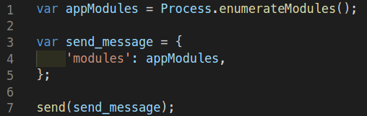
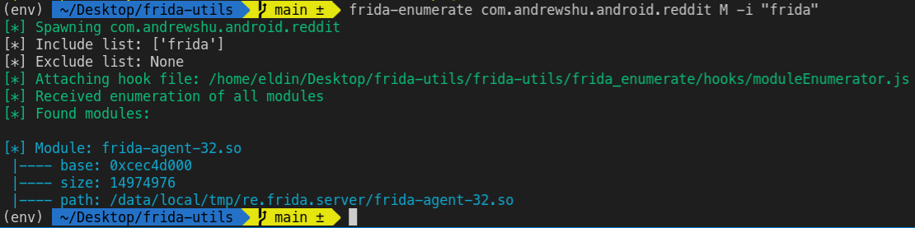
frida-enumerate

Slide 5
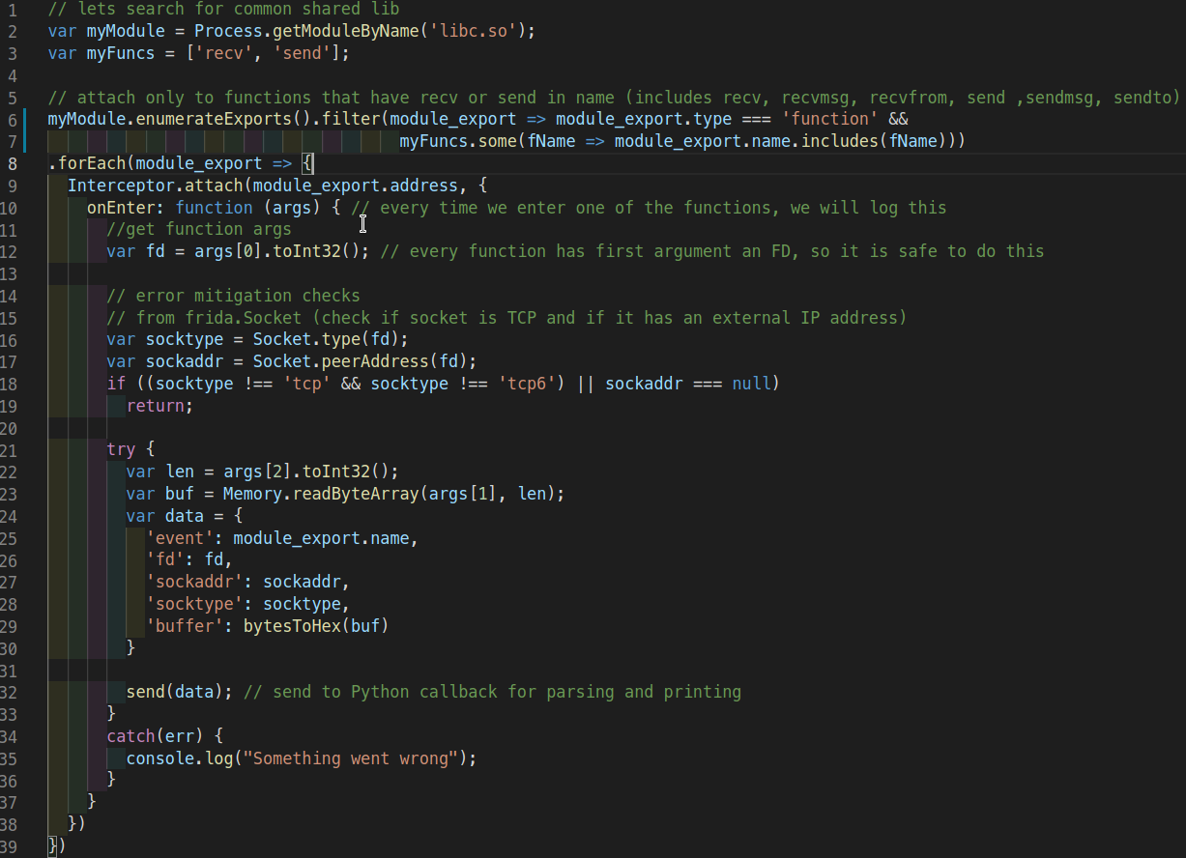
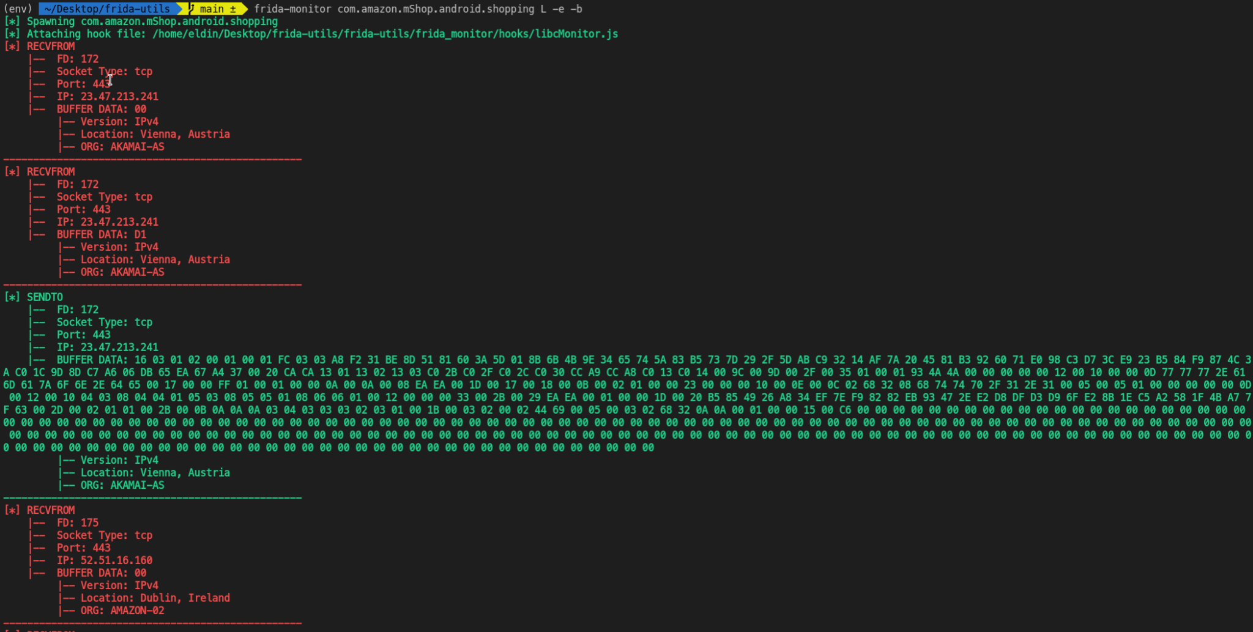
frida-monitor (libc.so)
Continuous monitoring using Interceptor
address accesses interception and function overloading
Monitor libc for network traffic

Slide 6
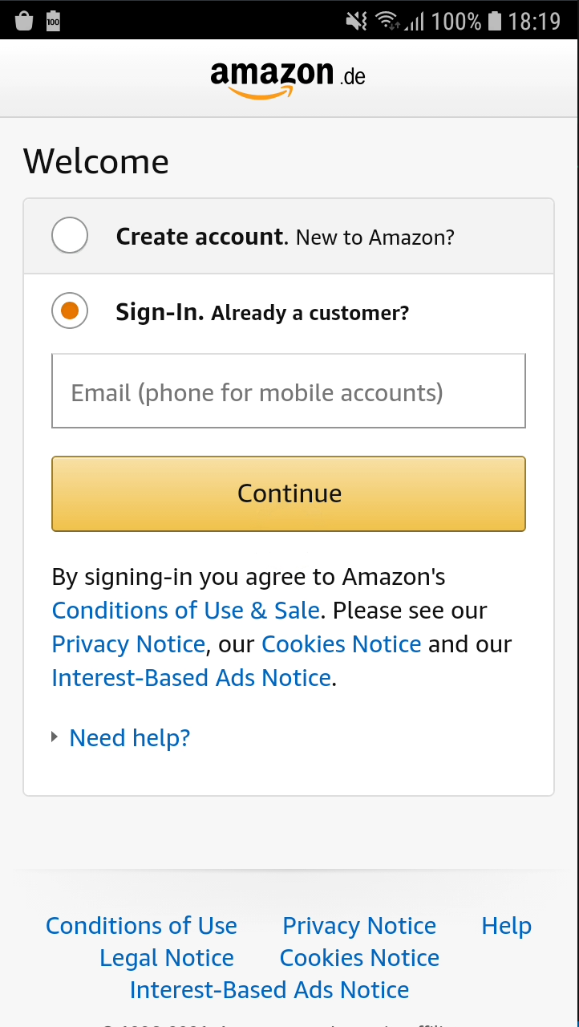
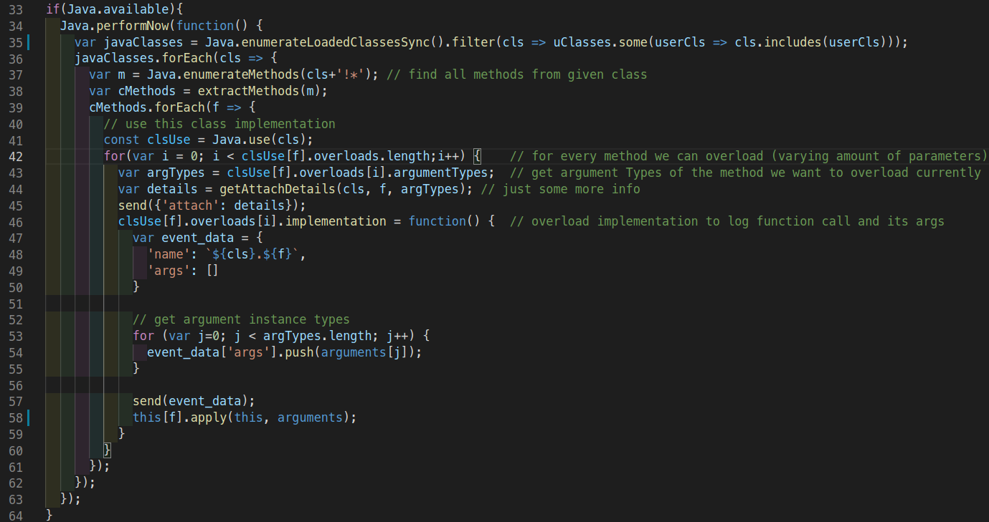
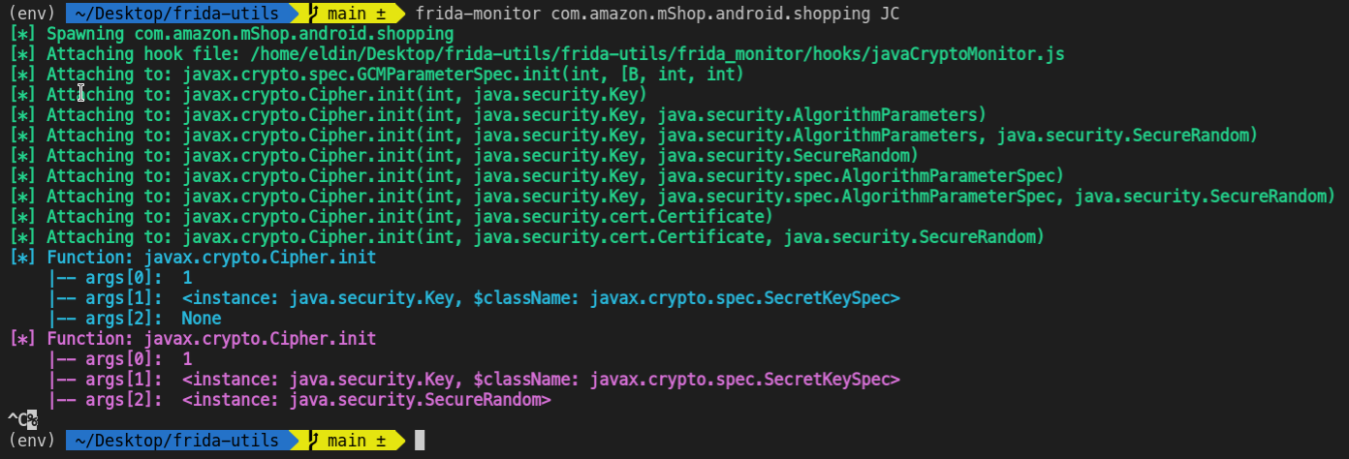
frida-monitor (javax.crypto.Cipher)
Highlight Java crypto.Cipher calls

Slide 7
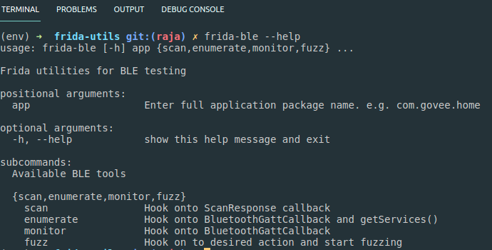
BLE Tool
Analyse BLE applications and BLE devices
Check scan data
Enumerate device - get complete GATT profile
Monitor the communication
Fuzz application and possibly BLE device
WHY?
Cheap
Fast
Does not need additional HW
Flexible

Slide 8
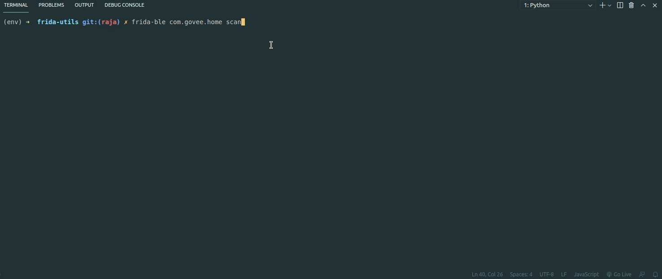
BLE Scan

Slide 9
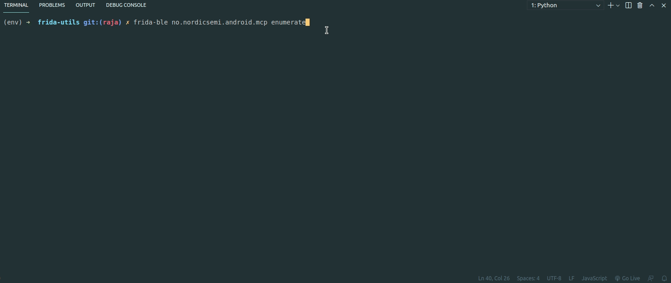
BLE Enumerate

Slide 10
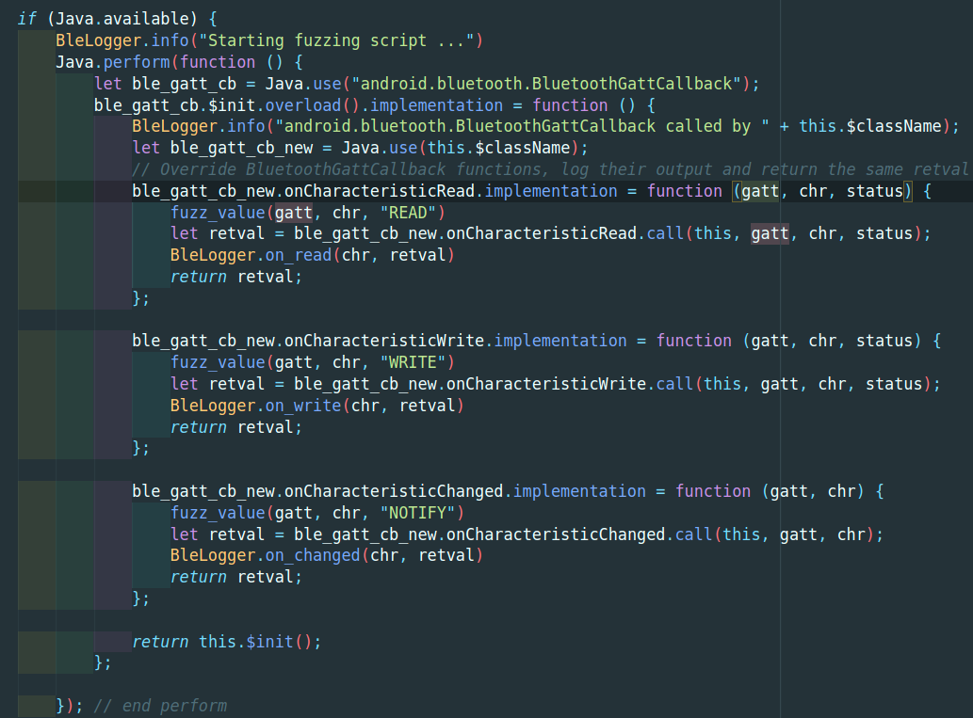
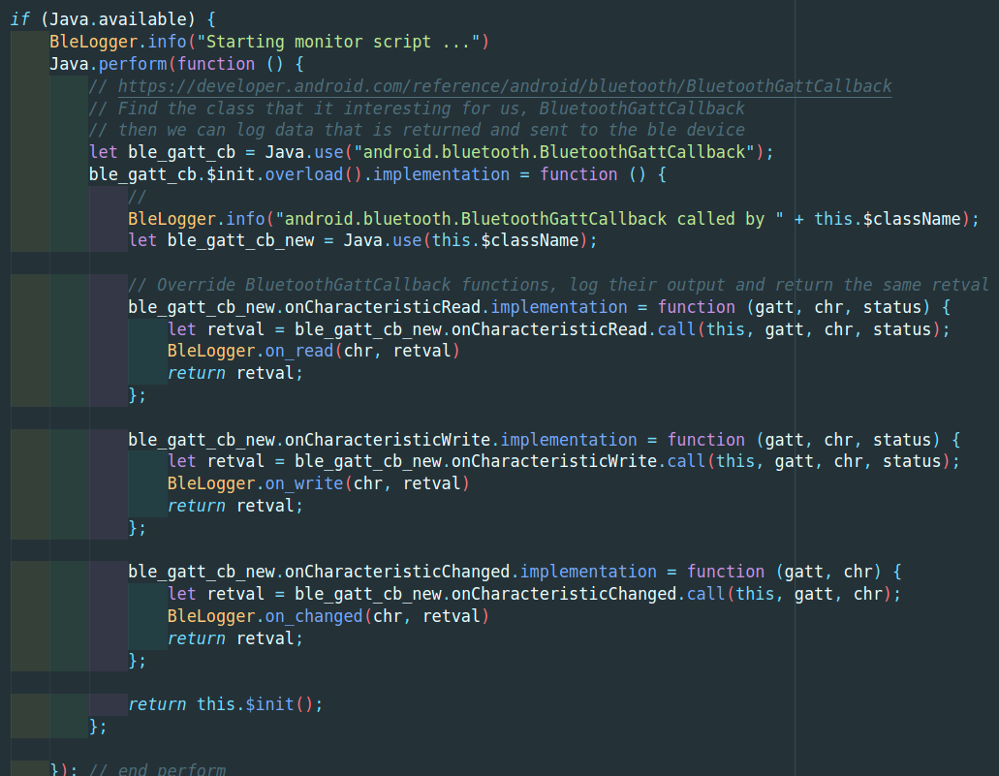
BLE Code

Slide 11
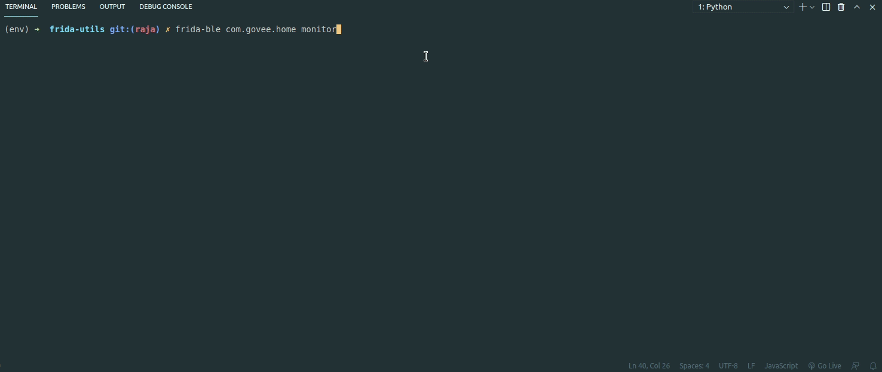
BLE Monitor

Slide 12
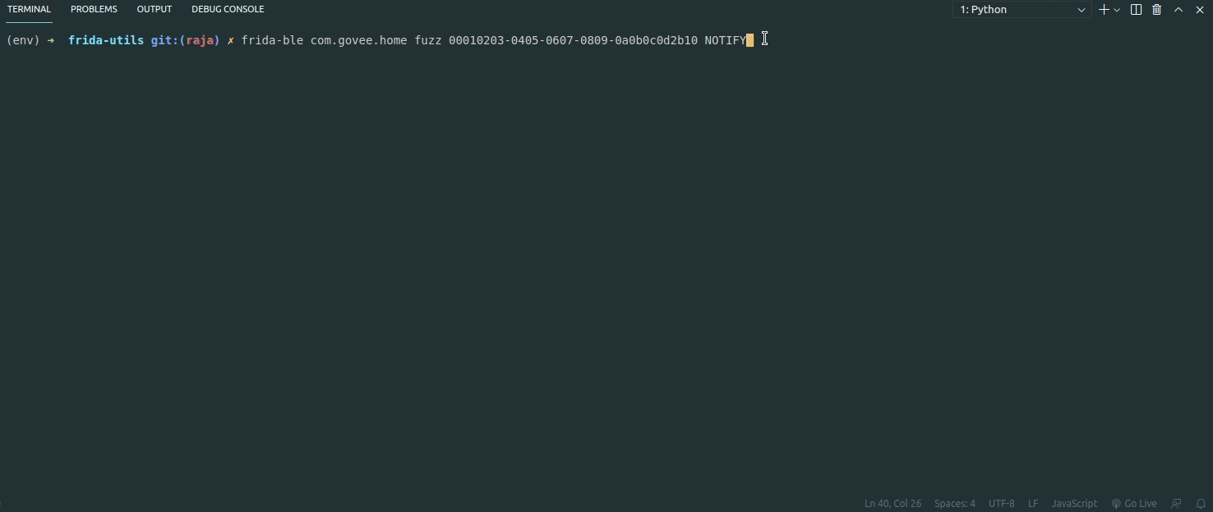
BLE Fuzzing

Slide 13
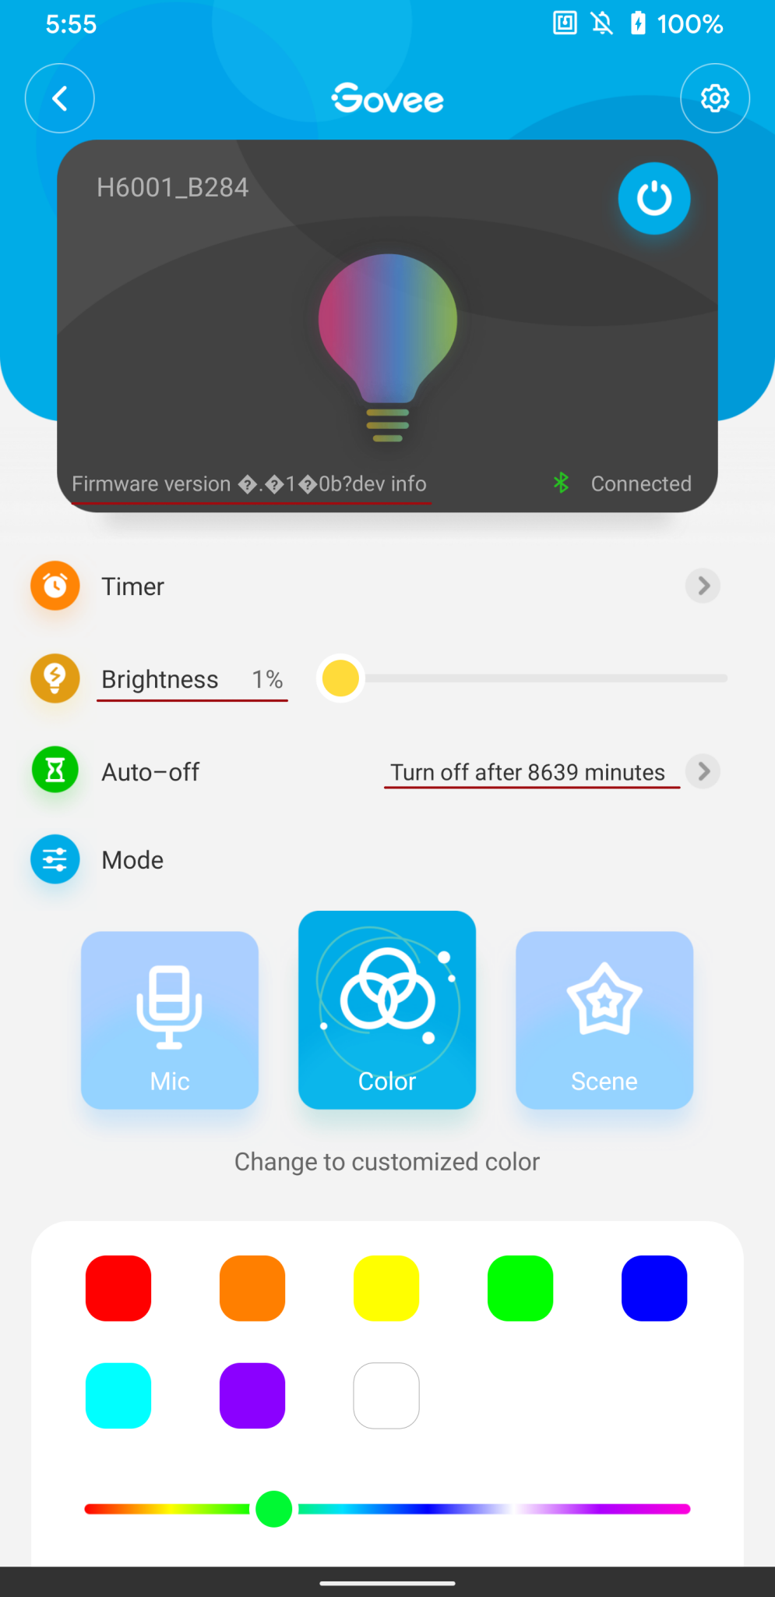
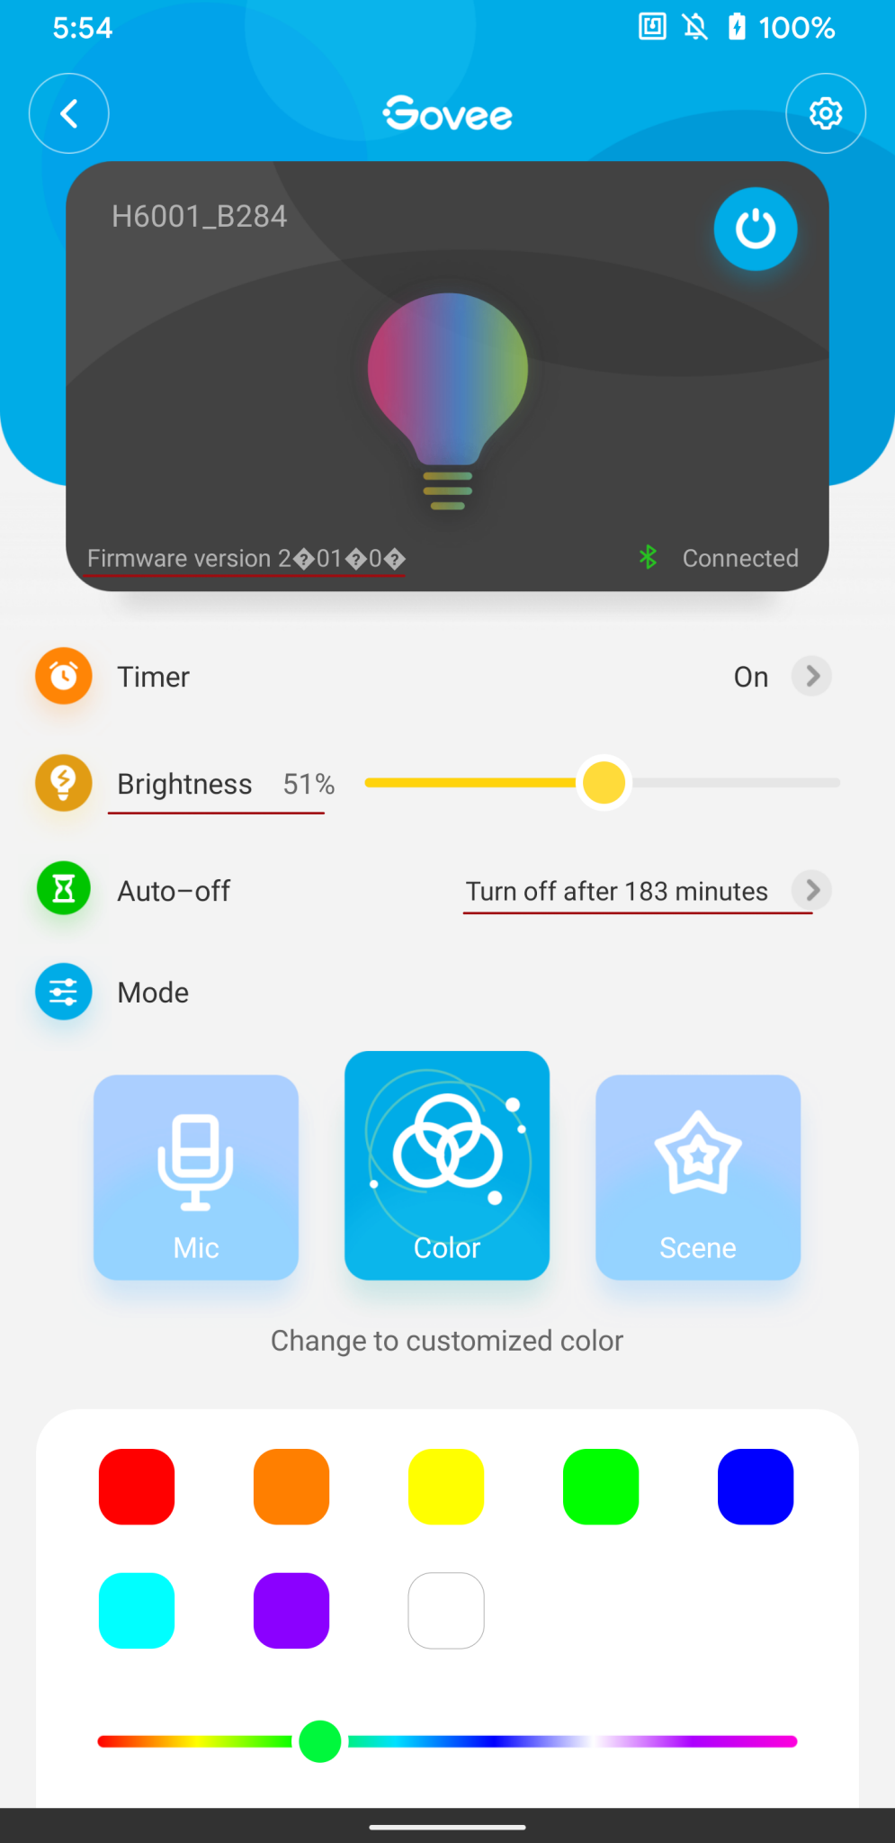
BLE Fuzzing

Slide 14
Thank you for your attention !

